Slide 1
Money Markets: What They Are, How They Work, and Who Uses Them. Archer, M. (2019)
Fact About Money Market
Fact about money market
The majority of money market transactions are wholesale transactions that take place between financial institutions and companies.
Who Uses the Money Market?
The major participants in the money market are commercial banks, governments, corporations, government-sponsored enterprises, money market mutual funds, futures market exchanges, brokers and dealers, and the Federal Reserve.
Why Is It Called the Money Market?
The money market refers to the market for highly liquid, very safe, short-term debt securities. Because of these attributes, they are often seen as cash equivalents that can be interchangeable for money at short notice.
Can You Lose Money in the Money Market?
For depositors, most money market accounts are insured by the FDIC up to $250,000 per institution.
What Are the Downsides of Money Markets?
Because they are virtually risk-free, money market investments also come with very low interest rates - often the risk-free rate of_return.
Why Is It Called the Money Market?
The money market refers to the market for highly liquid, very safe, short-term debt securities. Because of these attributes, they are often seen as cash equivalents that can be interchangeable for money at short notice.
Can You Lose Money in the Money Market?
For depositors, most money market accounts are insured by the FDIC up to $250,000 per institution.
What Are the Downsides of Money Markets?
Because they are virtually risk-free, money market investments also come with very low interest rates - often the risk-free rate of_return.
The Bottom Line
Money market accounts and money market funds are considered among the safest ways to invest one's money. They also have much lower returns than other investments, often even less than inflation.
Because they are so low risk, many people and businesses use money markets as a short-term investment for their cash reserves.

Slide 2
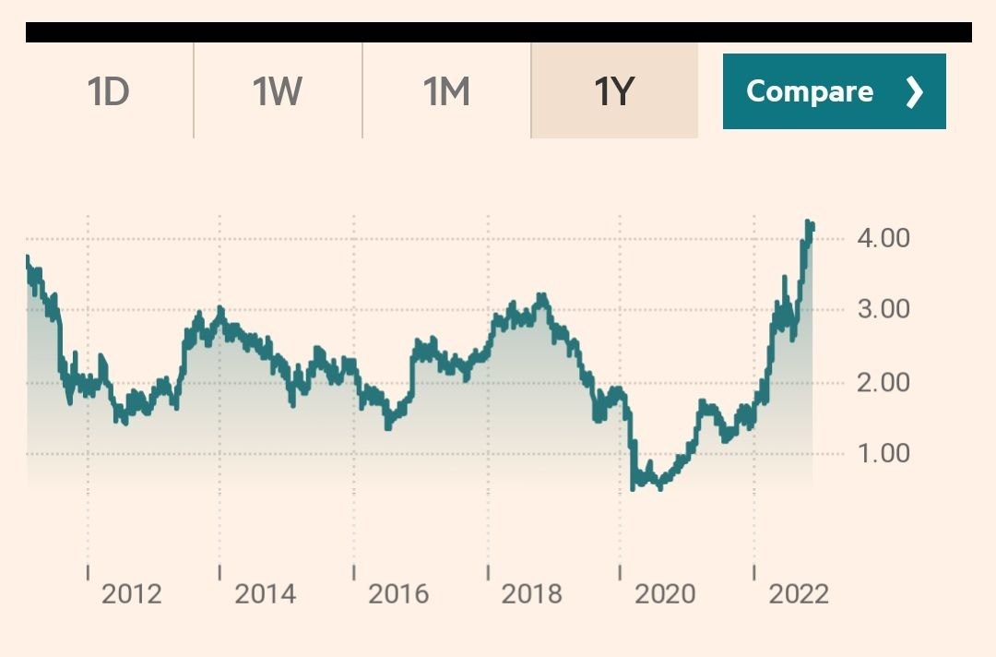
U.S. Treasury yields declined across the board on Thursday after the October consumer price index report, a measure of inflation, came in weaker than expected, signaling that price increases have likely peaked. The benchmark 10-year Treasury yield slumped 18 basis points to 3.946%, falling below the key 4% level. The yield on the 2-year Treasury fell 23 basis points to 4.395%.
(Money market finance policy chart, 2020)

Slide 3
References
Money market finance policy. (2020). Consolidated Financial Statements (IFRS 10). International financial reporting standards. https://markets.ft.com/data/bonds/tearsheet/summary?s=US10YT
Baral, P., Larsen, M., & Archer, M. (2019). INSTRUMENT OF MONEY POLICY? Restoration financing in Southeast America. Atlantic Council. https://www.investopedia.com/terms/m/moneymarket.asp /

